Slide 1
Human Movements
By
RABIA
Sports Sciences & Physical Education , LCWU

Slide 2
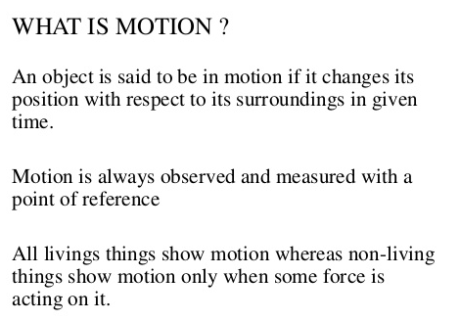
Motion

Slide 3
Forms of Motion
Most human movement is general motion, a complex combination of linear and angular motion components.
Since linear and angular motion are “pure” forms of motion, it is sometimes useful to break complex movements down into their linear and angular components when performing an analysis.

Slide 4
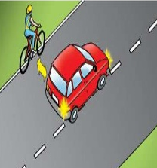
Linear Motion
linear motion involves uniform motion
Linear motion is also referred to as translatory motion, or translation.
Example
A sleeping passenger on a smooth airplane flight is being translated through the air.
Linear motion may also be thought of as motion along a line.

Slide 5
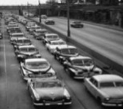
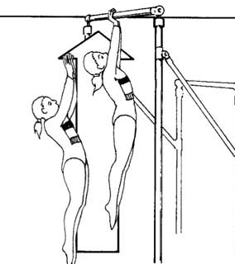
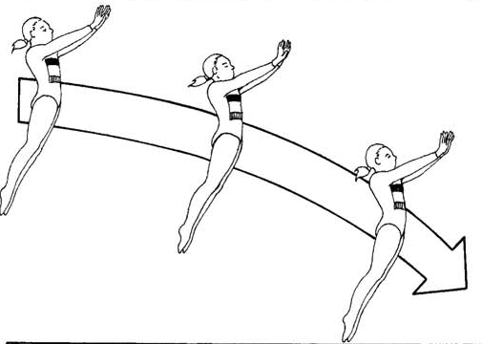
Rectilinear & Curvilinear Motion
If the line is straight, the motion is rectilinear
If the line is curved, the motion is curvilinear.

Slide 6
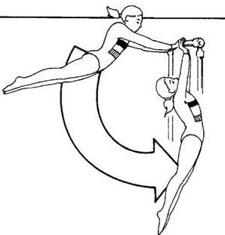
Angular Motion
Angular motion is rotation around a central imaginary line known as the axis of rotation, which is oriented perpendicular to the plane in which the rotation occurs. When a gymnast performs a giant circle on a bar, the entire body rotates, with the axis of rotation passing through the center of the bar.

Slide 7
General Motion
When translation and rotation movement are combined, the resulting movement is general motion.
Example
A football kicked end over end translates through the air as it simultaneously rotates around a central axis
A runner is translated along by angular movements of body segments at the hip, knee, and ankle.
Note: Human movement usually consists of general motion rather than pure linear or angular motion.

Slide 8
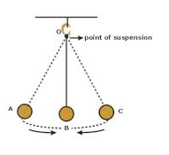
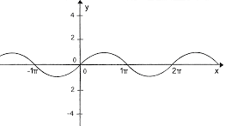
OSCILLATING MOTION
Something that oscillates moves back and forth. Anything that repeats the motion cycle after a certain period is considered to be oscillating.
This type of motion is found everywhere in our world.
Example:
The pendulum of a clock or Simple pendulum
Sound waves.

Slide 9
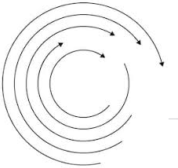
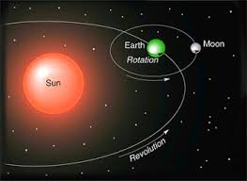
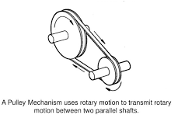
ROTARY MOTION
Rotary motion is anything that moves in a circle.
Example:
Movement of earth around Sun.
And movement of moon around earth
Rotation & revolution of earth

